Slide 1

Zillow Research
Olenka Besaga
ECO 590
Professor Kaltenberg

Slide 2


Research Question
How does the type of heating affect housing price in New York State for residential properties?

Slide 3

Data
The Zillow data is used from Bridge Interactive.
Two components:
The platform dashboard: for managing data access, API tokens and documentation
The data transports: RESO Web API, RETS and Bridge Web API.
The Bridge API platform allows users to request access to various datasets made available by Zillow Group. They have Public Records (United States), Zillow Zestimates and Zillow Group Econ data. Once access has been granted (token given), developers are able to integrate with our native API to get approved data.

Slide 4
Variables
Electric
Forced Air
Wood
Heat Pump,
Boiler
Property Type
Bedrooms Total
Days On Market
State
Lot Size Square Feet
Original List Price
Rooms Total
Year Built
Postal Code
Latitude
Years Old
Stories
Why I chose my variables?
Analyze the pricing of properties
Most interesting to me
Help to account for the unique characteristics of each property
Allows for a more accurate analysis of pricing trends and factors influencing property values.

Slide 5
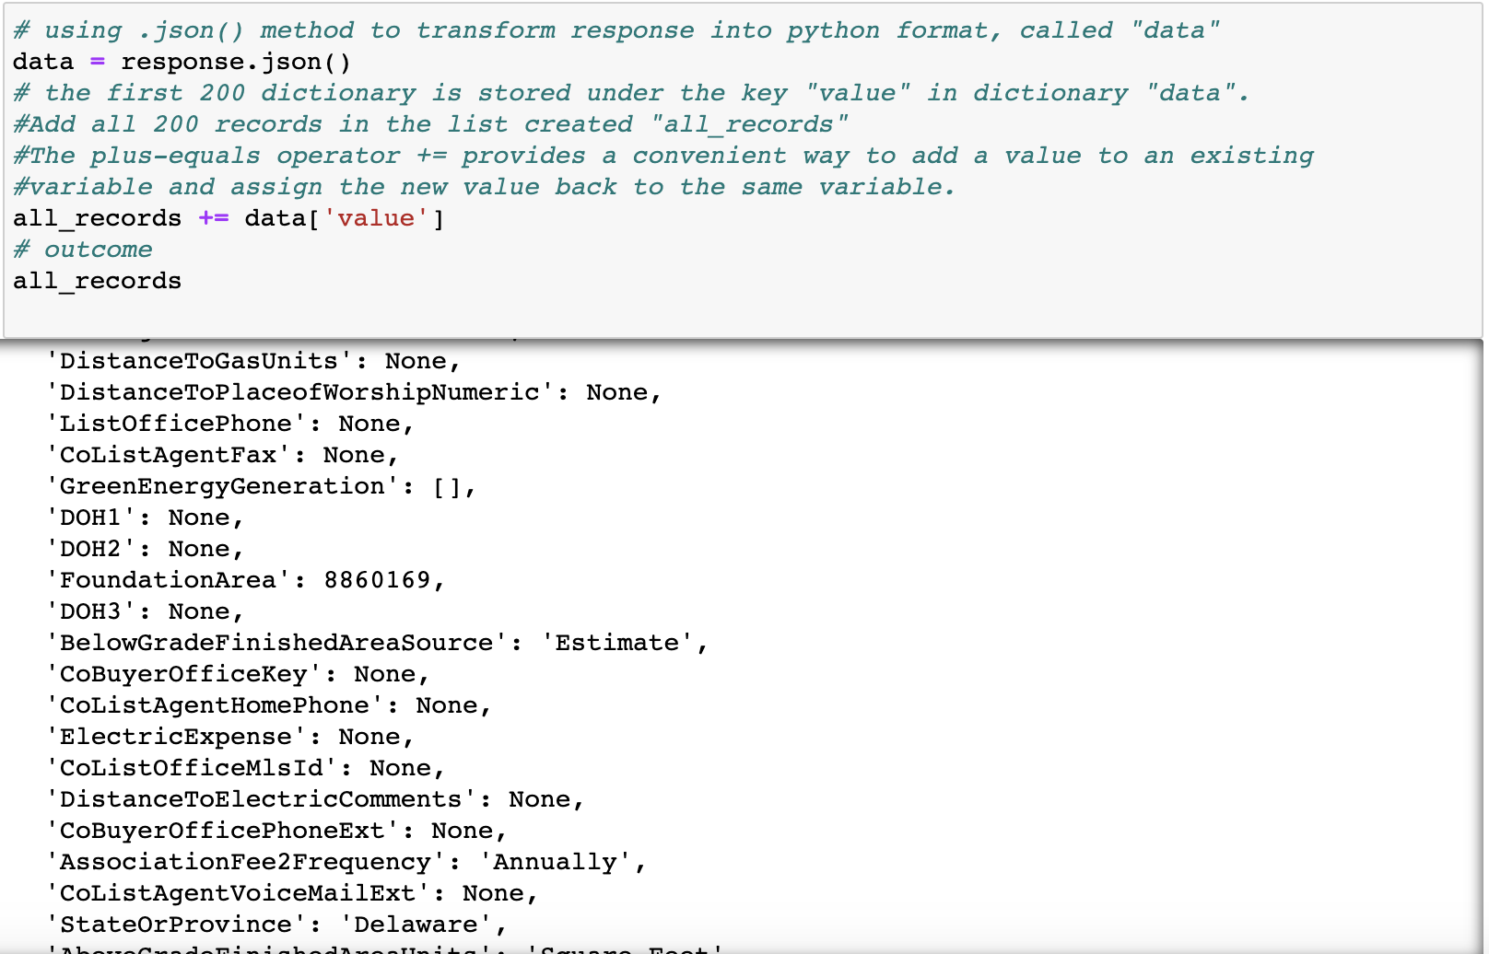
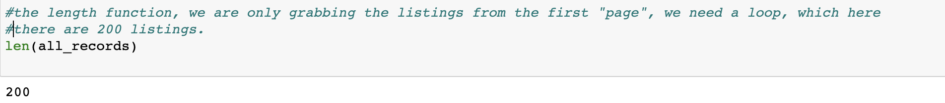

Data Cleaning

Slide 6
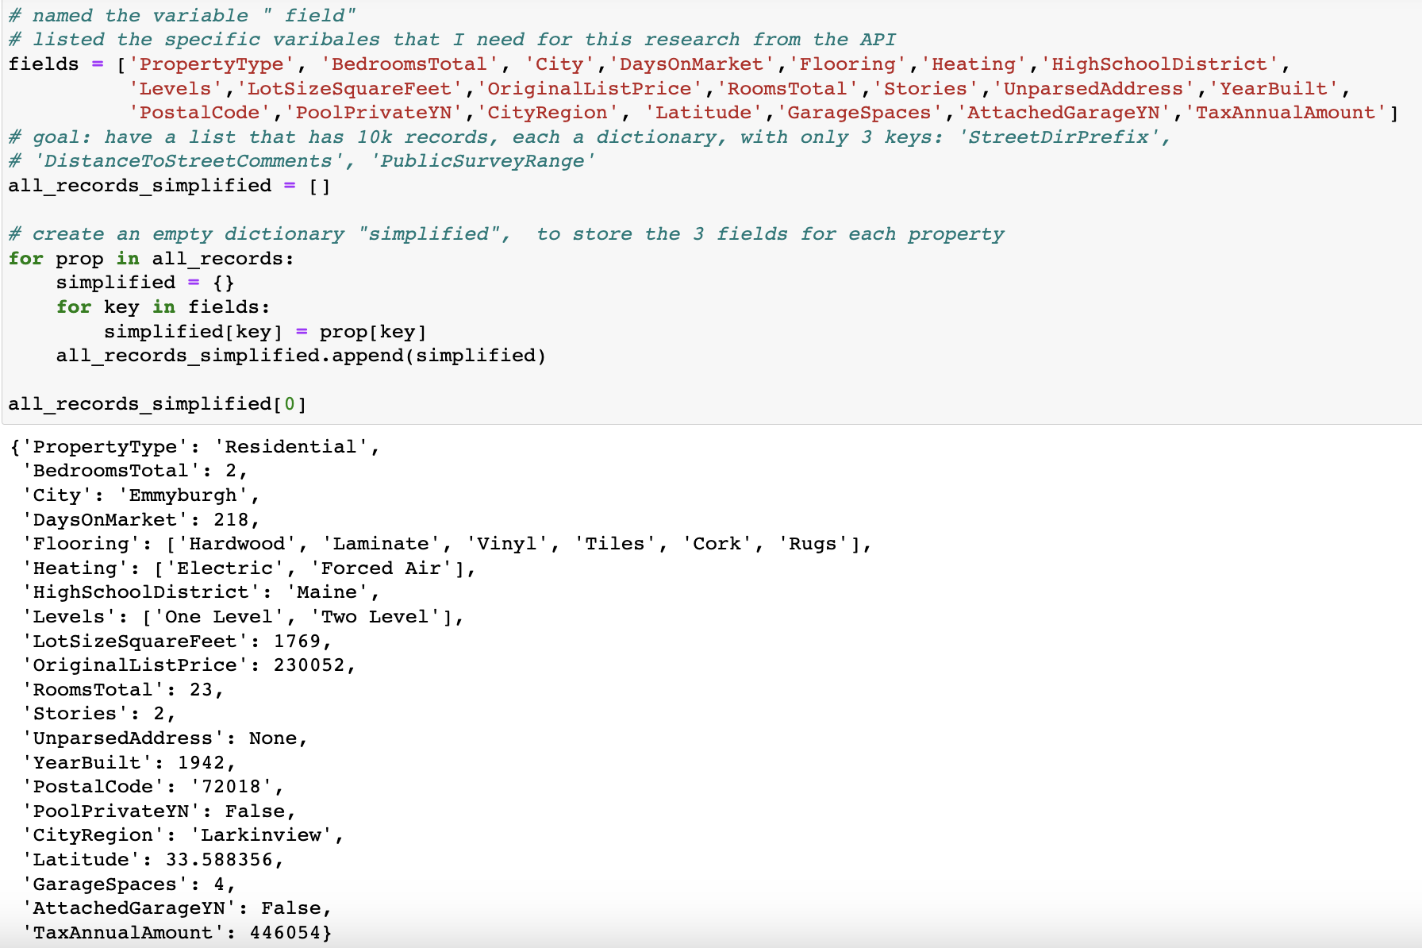
Continuation

Slide 7
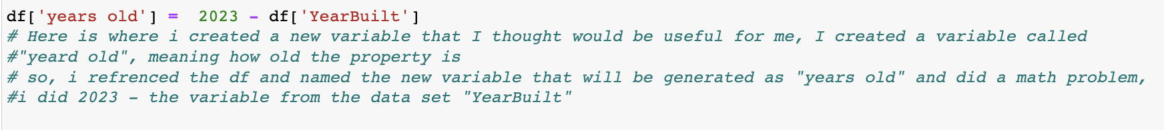
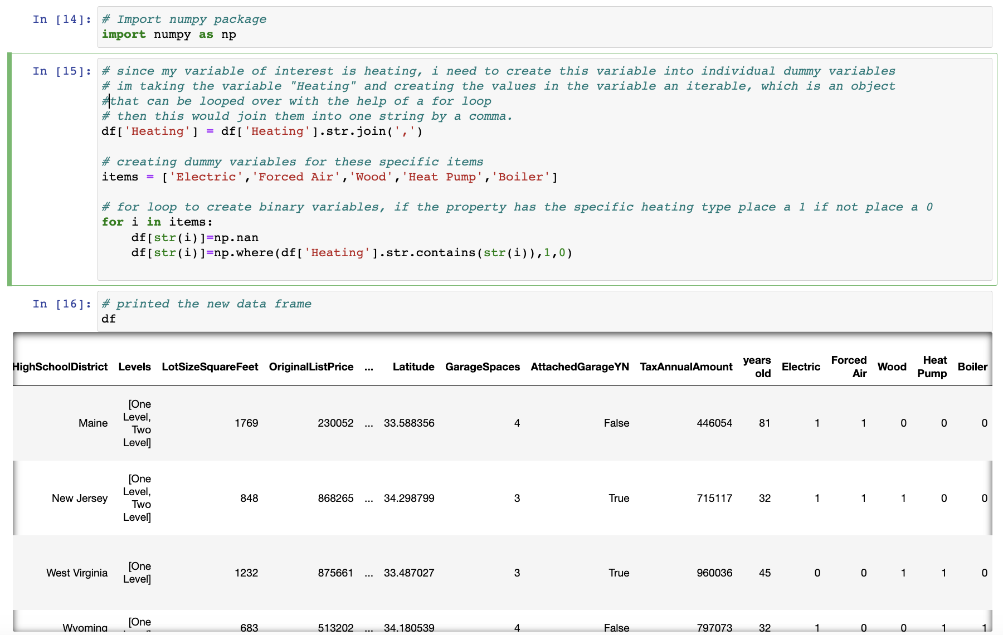
New Variable
Binary Variables for Heating Types

Slide 8
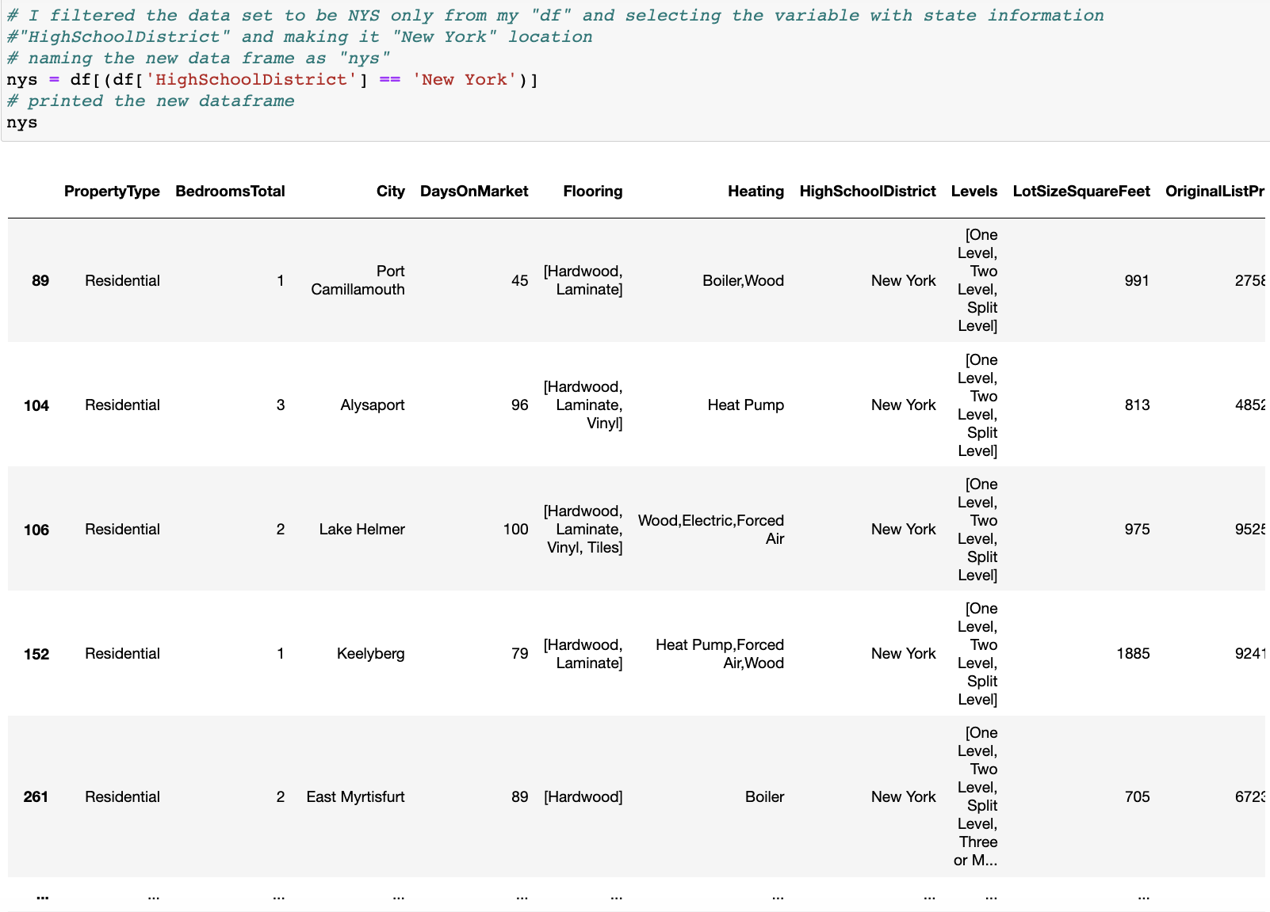
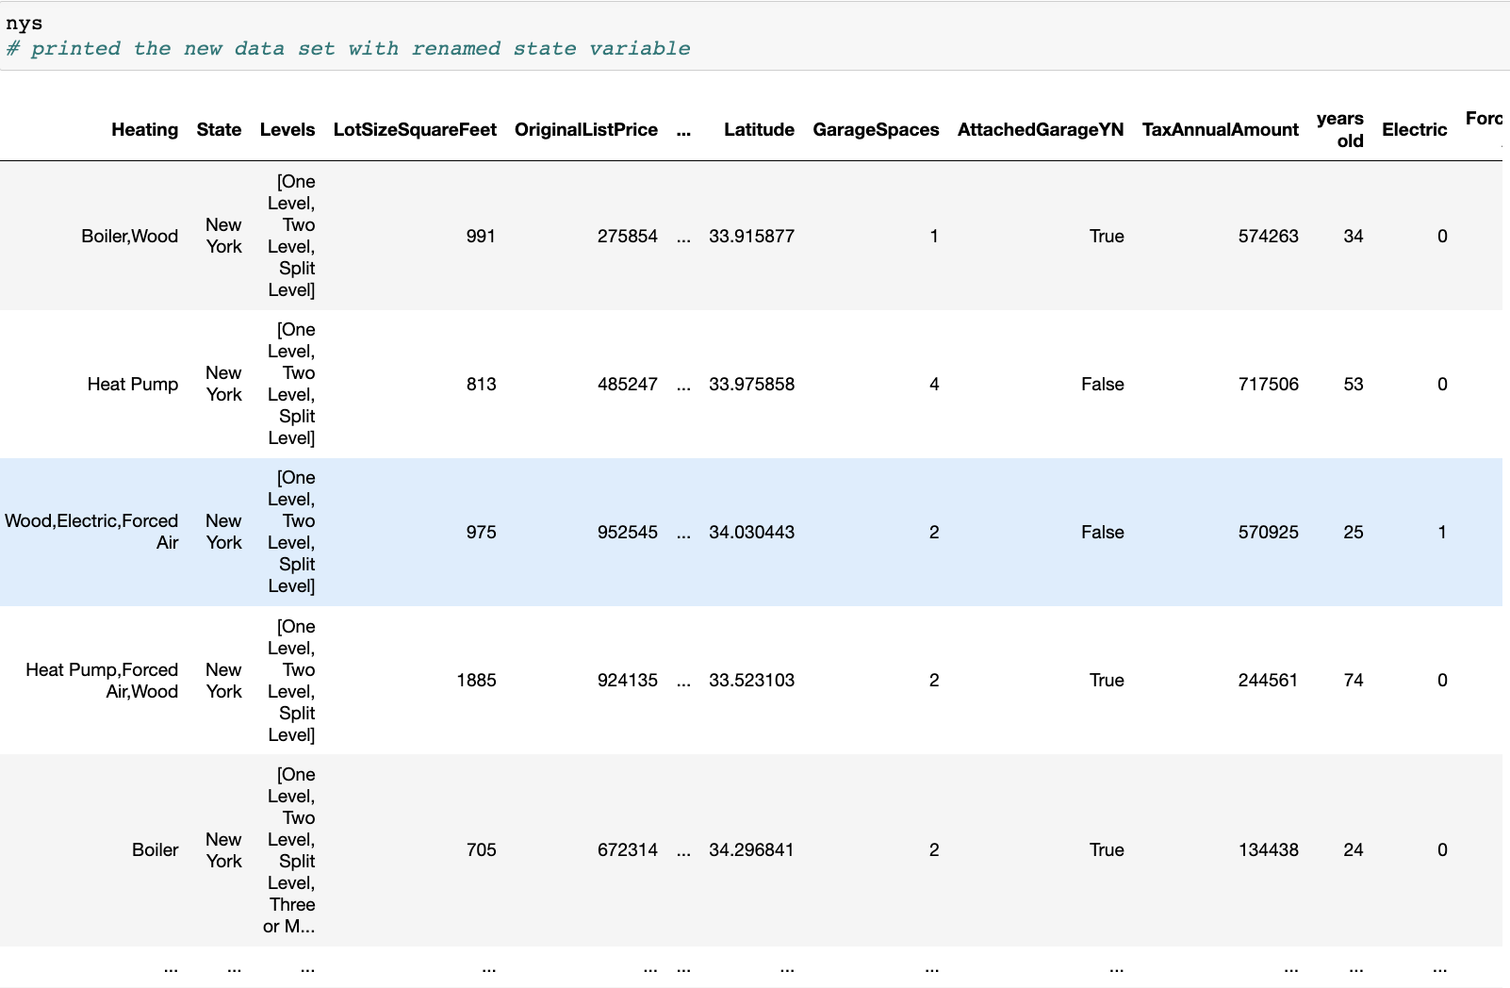

Location Filter – New York State

Slide 9
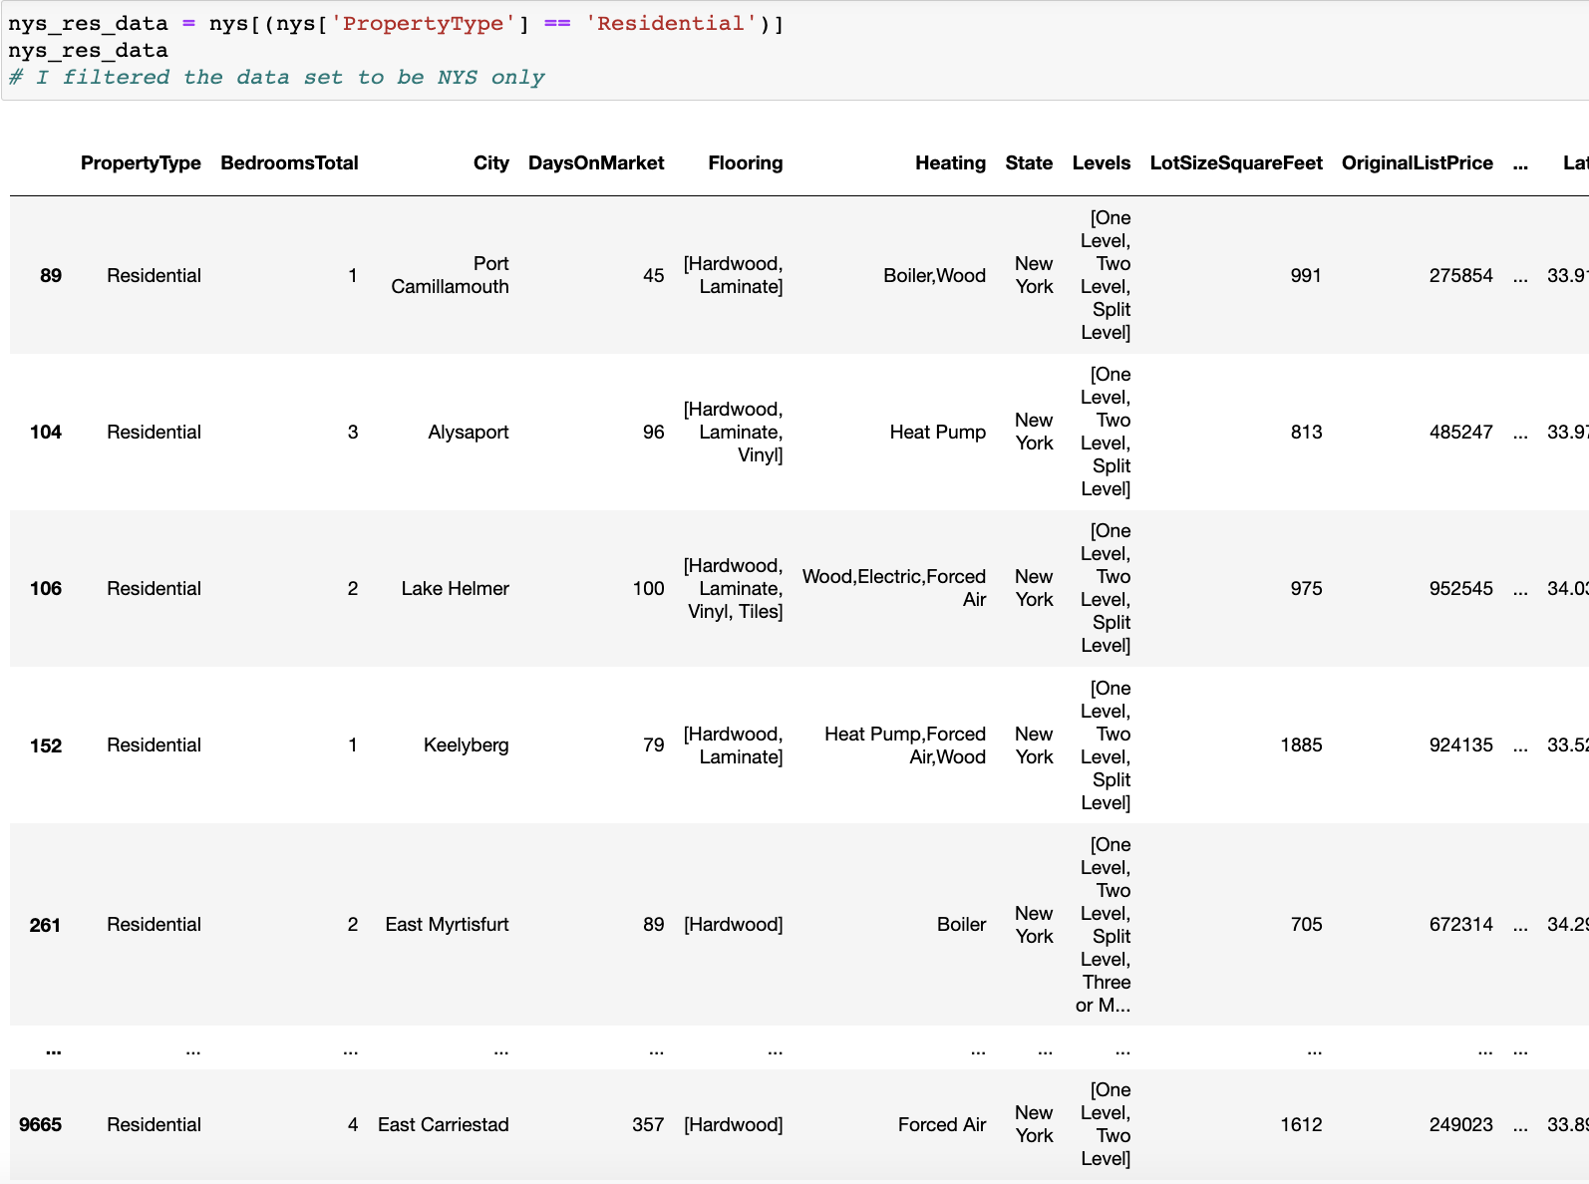

Property Type Filter – Residential Property

Slide 10
Difficulties
This wasn't the best API, it was not cleaned,
Few variables there would be Latin "filters"
For the cleaning part of coding, it was challenging however, the notes really were helpful for me. The little parts, such as missing characters was where it got me.
In addition, I had a hard time creating binary variables for the heating types, however, Professor Kaltenberg really helped me out and I finally understood the problem.

Slide 11
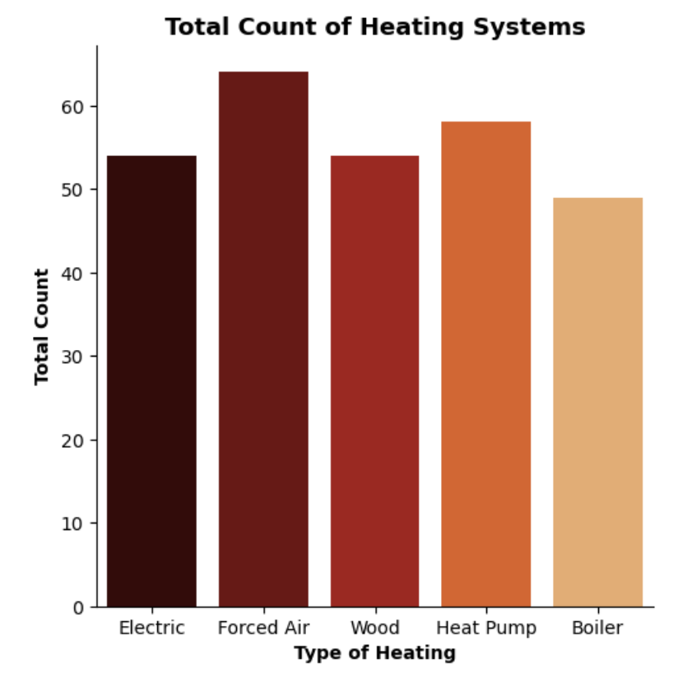
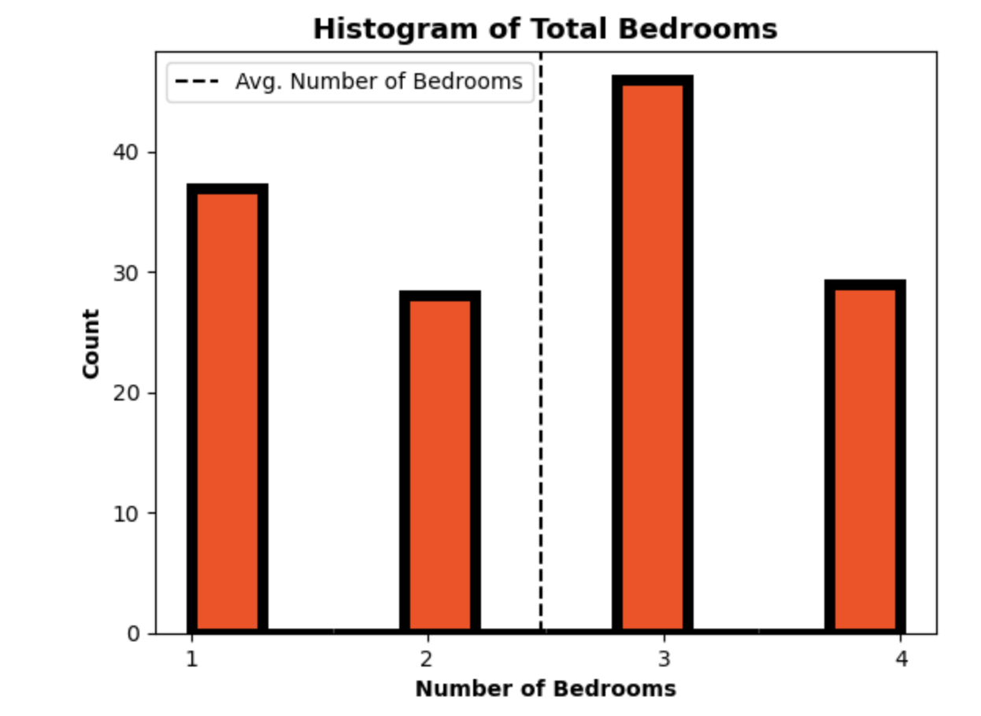
Graphs

Slide 12
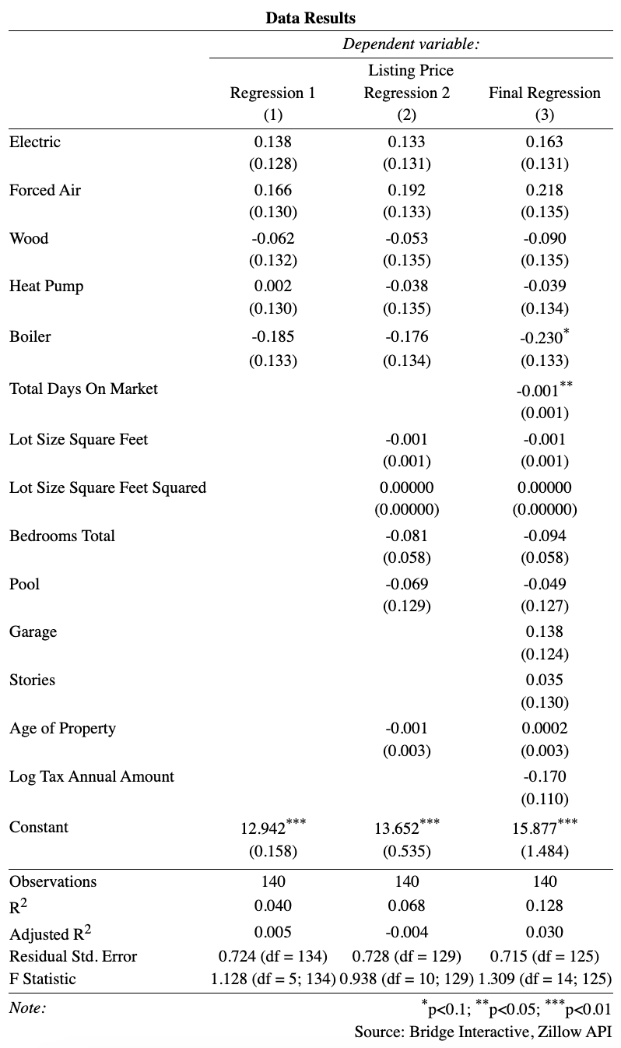
Model and Regression

Slide 13
Discussion
Holding all the variables constant, regression 1,2, and 3 show that forced air heating system have the highest average effect in increasing value of a residential property.
Regression 3, shows that on average, if a property has a boiler as a type of heating, there is a decrease of 23% in the price of the property. In addition, it was statistically significant at the 10% confidence level. Also, for every additional day the residential property is on the market, there is a decrease of 0.1% on the property, on average, holding all else of the variables constant with a 95% confidence level.
Regression 3 shows that the age of the property has no significant effect on value of the property about an increase of 0.02%, holding all else constant.
The interest variables in regression 3 shows that:
On average, if a property has an electric as a type of heating, there is an increase of 16.3% in the price of the property, holding all else constant.
On average, if a property has a forced air as a type of heating, there is an increase of 21.8% in the price of the property, holding all else constant.
On average, if a property has a wood as a type of heating, there is a decrease of 9% in the price of the property, holding all else constant.
On average, if a property has a heat pump as a type of heating, there is a decrease of 4% in the price of the property, holding all else constant.
On average, if a property has a boiler as a type of heating, there is a decrease of 23% in the price of the property, holding all else constant.

Slide 14
Future Research
Focus on a specific location in NYS
Increase the sample size and diversity of the properties studied
Control for other factors that may influence property value

Slide 15
Conclusion
The data and the variables were found to be not statically significant
Sample size too small
Poor data collection
Selection and presentation bias
Confounding variables
The type of heating system in a house can affect its value based on factors such as efficiency, maintenance and repair costs, and safety risks.
Overall, the study found that properties with more efficient and effective heating systems tend to have higher prices and values than those with older or less efficient systems.
Specifically, the study found that properties with forced-air heating, electric tended to have higher prices and values than those with wood heating, heat pump or other less efficient systems.

Slide 16
Sources
https://bridgedataoutput.com/docs/explorer/public-data
https://smarterhouse.org/heating-systems/types-heating-systems
https://listwithclever.com/real-estate-blog/how-your-homes-heating-system-can-impact-sale-price/

Slide 17

Thank you!!

